Slide 1
Advanced OO Programming and Design Course number: 157109
Course overview, Intro to UML

Slide 2



Nice to meet you
Dr. Shahar Golan
golansha@gmail.com
Office: Weiler Building, 217
Office hours: Coordinate by email

Slide 3
Agenda
Course overview
Syllabus
Background
Subjects
Static structure modeling
UML
Class, Interface
Relationship types

Slide 4
Course overview

Slide 5
Grade components
Course overview - syllabus
Final exam: 70%
Homework assignments: 30%
5/6 programming assignments: 20%
4 theoretical assignments: 10%
Submission in pairs – both partners should submit
No late submissions
Individual requests – only based on the regulations
General requests – only from the students’ representative
Special extensions must be documented
You must pass both the exam and the assignments to pass the course

Slide 6
Home assignment solution
Course overview - syllabus
The goal of the home assignments is to help you gradually assimilate the course material
A student who shares a solved exercise in any form or uses a shared solution in any way will receive a grade of 0 for that exercise and will be sent to the disciplinary committee.
General discussion is encouraged. The line passes in sharing a solution with a student who is not your partner. Solving the assignment with anyone or asking anyone about her solution is treated as solution-sharing.

Slide 7
Active participation in lectures
Course overview - syllabus
Success in the course is not possible without participation and involvement
Not everything is detailed in the slides
The student is expected to
attend class
ask questions for the sake of elaboration
participate in class discussions

Slide 8
Course Background

Slide 9
Background: Premises
Course overview - background
The scope of a software project can be huge
A medium-sized project contains tens of thousands of lines of code
A software project is a team effort
A software project is a dynamic process
Incomplete requirements
Incorrect requirements
Changing requirements
Evolving requirements

Slide 10
The motivation behind OO design
Course overview - background
The human ability to understand many details is limited
People tend to make mistakes, especially when repetitive, technical tasks are involved
People are good at grasping abstract concepts

Slide 11
The goal: quality code
Course overview - background
Easy to write*
Easy to understand*
Easy to change*
Easy to re-use*
Easy for cooperative work*
Reliable
* Easy = not a nightmare

Slide 12
The means: OO programming and design
Course overview - background
UML: Unified Modeling Language
Class design principles
Generic programming
Packages design principles
Design patterns
Using Frameworks based on design patterns

Slide 13
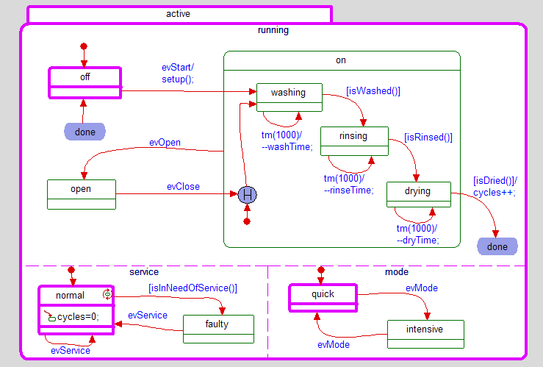
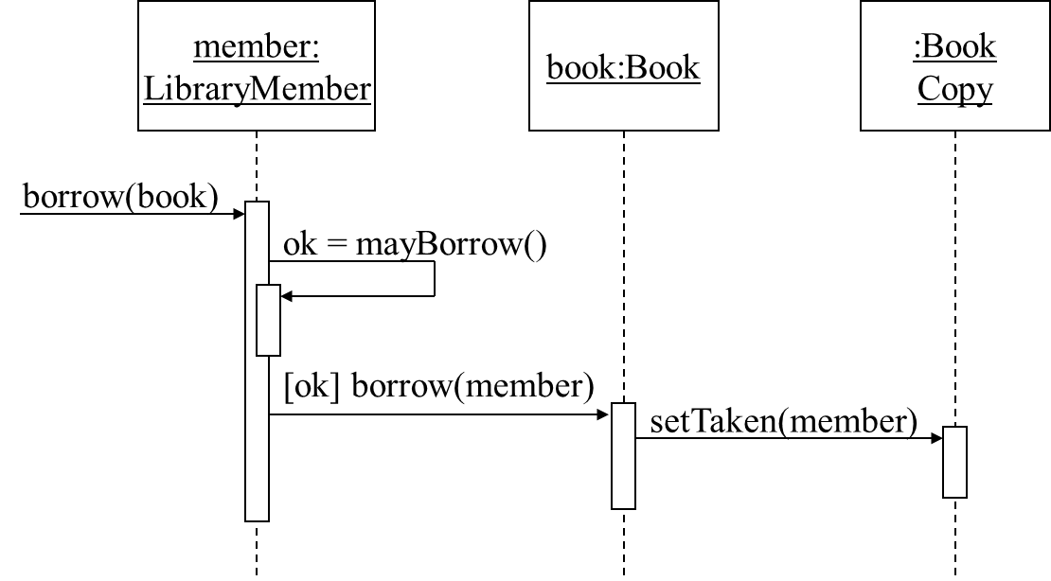
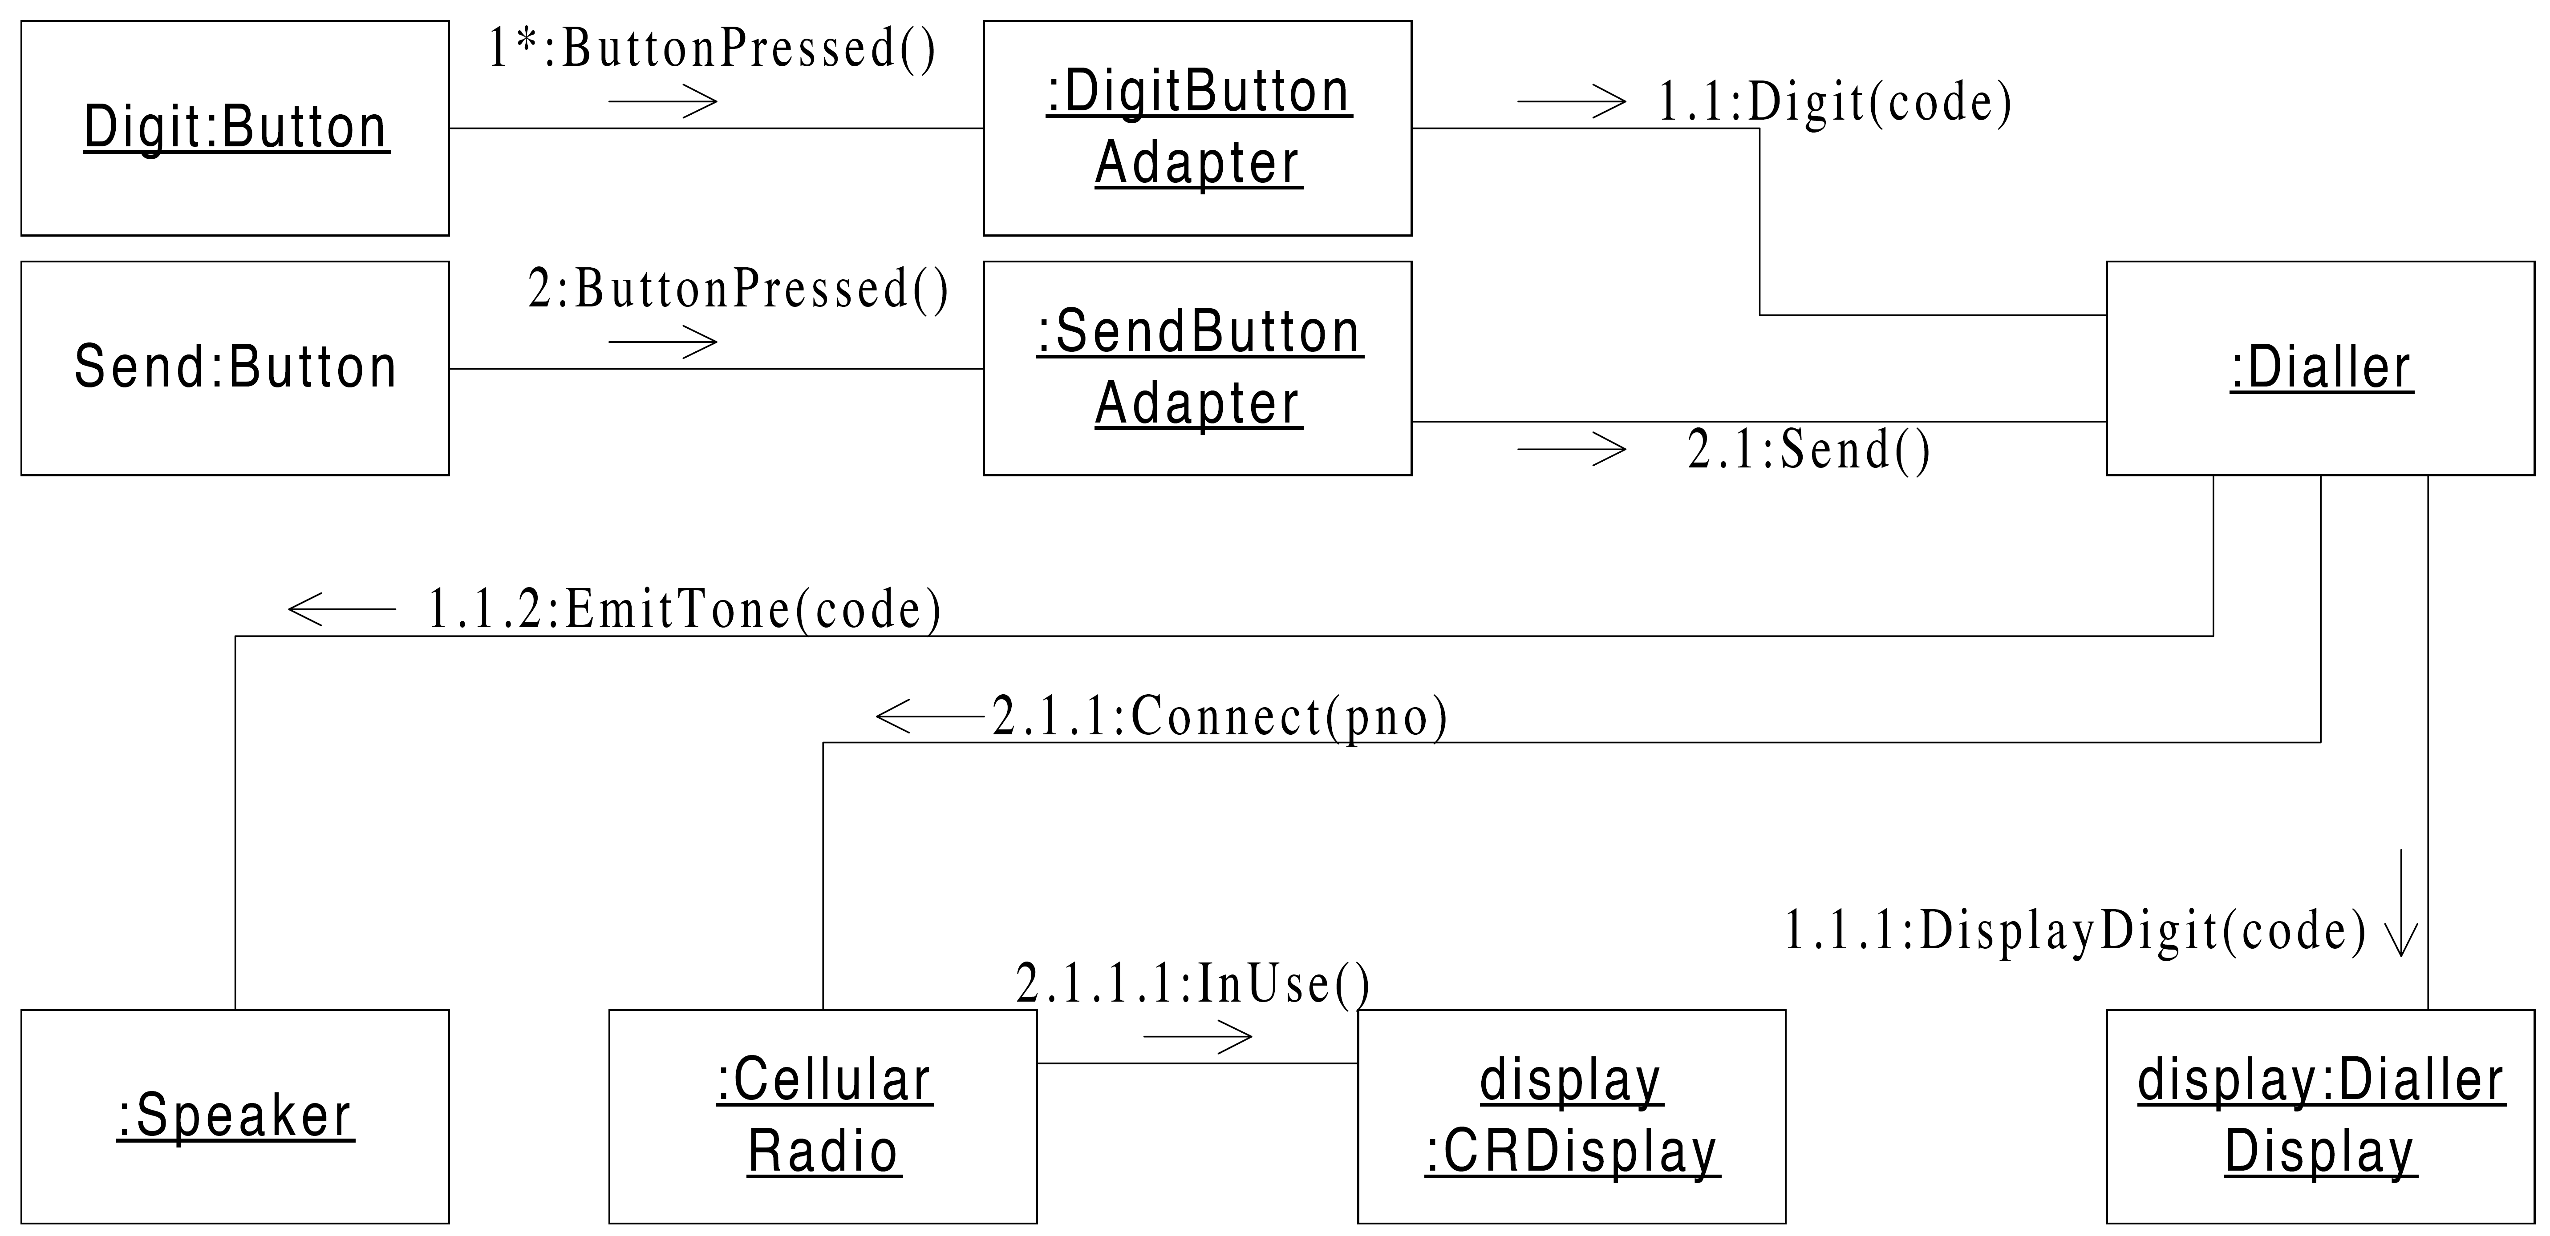
UML: Unified Modeling Language
Course overview - subjects
UML: Unified Modeling Language
Precise understanding of the UML language
Correct “translation” from UML to code and back
Class diagram
Interaction diagrams
Sequence diagram
Communication diagram
Statecharts

Slide 14
Class design principles
Course overview - subjects
“SOLID”
Single Responsibility Principle
Open Closed Principle
Liskov Substitution Principle
Interface Segregation Principle
Dependency Inversion Principle

Slide 15



Generic programming
Course overview - subjects
Generic class definition & usage
Lambda expressions
Using Java streams

Slide 16

Package design
Course overview - subjects
What is the definition of a software package?
What are the concepts which affect package design?
Responsibility, independence, abstraction, stability
Measures for evaluating package design quality

Slide 17
Package design principles
Course overview - subjects
Cohesion-related principles
Reuse/Release Equivalence Principle (REP)
Common Reuse Principle (CRP)
Common Closure Principle (CCP)
Coupling-related principles
Acyclic Dependencies Principle (ADP)
Stable Dependencies Principle (SDP)
Stable Abstractions Principle (SAP)

Slide 18

Design patterns
Course overview - subjects
Structural
Adapter
Composite
Bridge
Decorator
Flyweight
Proxy
Creational
Singleton
Abstract Factory
Factory method
Prototype
Behavioral
Observer
Iterator
Memento
Strategy
Command
Visitor
Template method
State

Slide 19
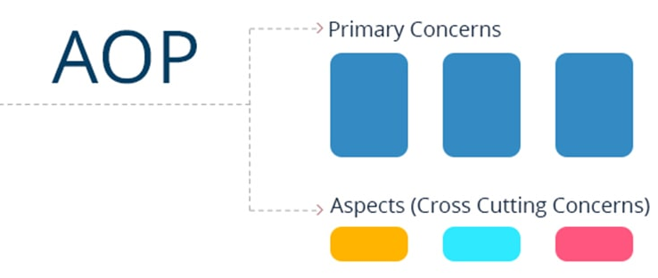

Frameworks usage based on design patterns
Course overview - subjects
Inversion of Control
Aspect Oriented Programming
Dependency Injection

Slide 20
Advanced OO Programming and design Course number: 157109
Modeling with Unified Modeling Language (UML)

Slide 21
Static structure modeling Class Diagrams

Slide 22
A simple Class Diagram
UML -> Class Diagram
Notes:
In this example there are no objects, and “Default” package is not displayed in the class diagram, although it could be.

Slide 23
Class
UML -> Class Diagram
Attribute name
Attribute type
Name
Access
Attributes
Constructor
Operations
Operation name
arguments
Return value type

Slide 24
Access modifiers
UML -> Class Diagram
public: ‘+’
protected: ‘#’ (sometimes denoted by 🔑)
private: ‘-’ (sometimes denoted by 🔒(
static: underlined

Slide 25
Interface
UML -> Class Diagram
Abstract operation

Slide 26
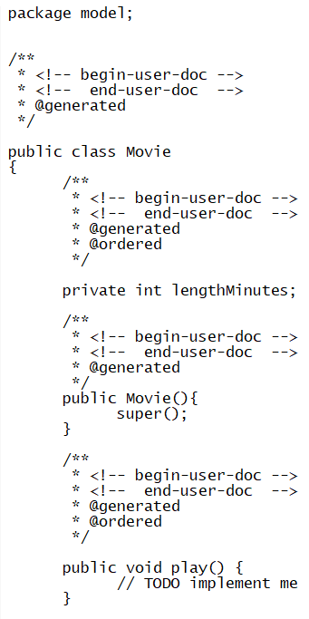
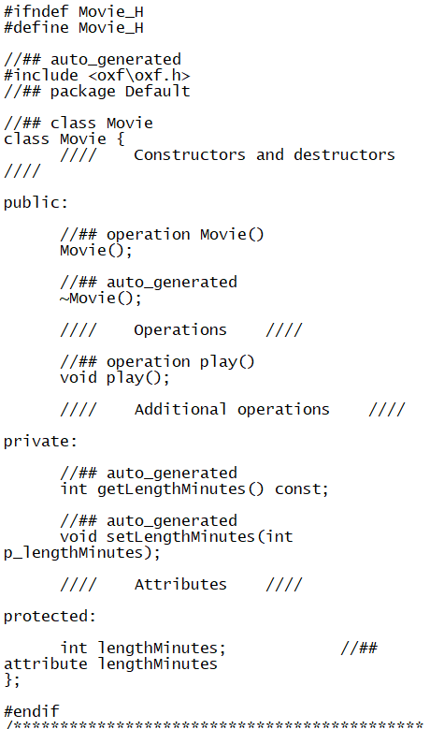
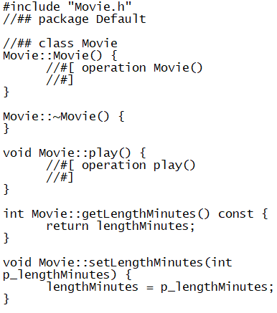
From UML to code
UML -> Class Diagram
Movie.java
Movie.h
Movie.cpp

Slide 27
From UML to code: Important note
UML -> Class Diagram
UML doesn’t fully define the implementation in every language
Are there getters? Setters?
Each language has its own mechanisms/constraints
The diagram describes the structure, composition and relationships between classes. At times there is no mechanism in a language which “enforces” the correct realization.
It is the responsibility of the developer to implement according to the diagram

Slide 28
Class Diagram – Relations

Slide 29
Relations: Overview
UML -> Class Diagram ->Relations
classes
Multiplicity
relationship type
Line type
Ends type
Field name
Direction
Notes:
Just highlights, perhaps just to mention difference between directional and bi-directional association, and difference between association and composition. Unfortunately did not have time to update slides following with Rhapsody 7.6.

Slide 30
Multiplicity
UML -> Class Diagram ->Relations
The default (if it does not appear): 1
3: fixed number
3..5: between 3 and 5
*: zero or more
2..*: two or more

Slide 31
Types of relationships between objects
UML -> Class Diagram ->Relations
Dependency
Association
Aggregation
Composition
Composite
Inheritance
Realization
Notes:
Just show these 2 slides, and explain some of the relations in following slides.

Slide 32
Dependency
UML -> Class Diagram ->Relations
Model
Semantics:
A knows B (A does not have a pointer to B)
Examples
B is passed to A’s constructor
A has a function which creates B
A has a function which returns B

Slide 33
Association
UML -> Class Diagram ->Relations
Directed Association
Bi-Directional Association

Slide 34
Directed Association
UML -> Class Diagram ->Relations
A
B
Model:
Semantics:
A uses a B (A has a pointer to B)
There is no ownership, one B can belong to multiple A’s
Examples
List of movies a person has seen
List of actors appearing in a movie
The movie’s director
itsB

Slide 35
Example of Directed Association
UML -> Class Diagram ->Relations

Slide 36
Bi-Directional Association
UML -> Class Diagram ->Relations
A
B
Model:
Semantics:
There is mutual use between A and B, a change in the association will affect both directions
Examples
Teachers-students
Doctors-patients
itsA
itsB

Slide 37
Example of Bi-Directional Association
UML -> Class Diagram ->Relations

Slide 38
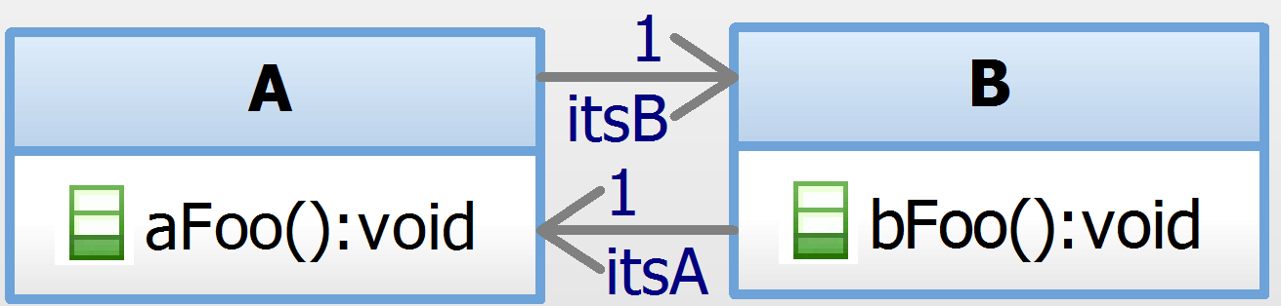
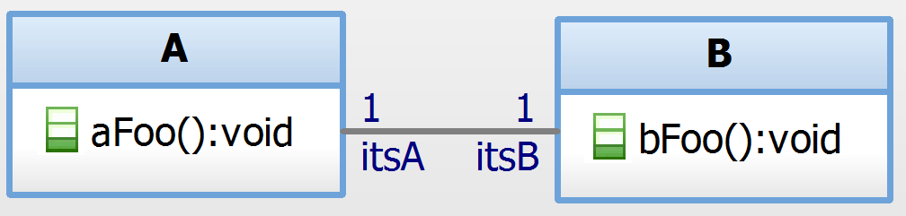
The difference between ‘directed’ and ‘bi-directional’
UML -> Class Diagram ->Relations
vs.

Slide 39
What will be done when running the following code?
UML -> Class Diagram ->Relations
An example of Directed Association
Given the following model:
A a = new A();
B b = new B();
a.setItsB(b);
A a1 = new A();
b.setItsA(a1);
a:A
b:B
a1:A

Slide 40
What will be done when running the following code?
UML -> Class Diagram ->Relations
An example of Bi-Directional Association
Given the following model:
A a = new A();
B b = new B();
a.setItsB(b);
A a1 = new A();
b.setItsA(a1);
a:A
b:B
a1:A

Slide 41
Aggregation
UML -> Class Diagram ->Relations
A
Model:
Semantics:
A special type of Association
A has a B
Ownership: any object of type B belongs to at most one object of type A
There is no existence-dependence: if an A is deleted, its B may still exist
Examples
List of employees in a department
B
itsB

Slide 42
Bi-Directional Aggregation
UML -> Class Diagram ->Relations
A
B
Model:
Semantics:
In addition to the ownership between A and B, B has a back-pointer to the A it belongs to.
A change in the relationship will affect both directions
itsA
itsB

Slide 43
Example of Aggregation
UML -> Class Diagram ->Relations

Slide 44
Composition
UML -> Class Diagram ->Relations
A
B
Model:
Semantics:
A special type of Aggregation
Ownership: any object of type B belongs to at most one object of type A
Existence-dependence: if A is deleted, its B is deleted
Examples
List of apartments in a building
List of departments in an organization
itsB

Slide 45
Bi-Directional Composition
UML -> Class Diagram ->Relations
A
B
Model:
Semantics:
In addition to the composition relationship between A and B, B has a back-pointer to the A it belongs to.
A change in the relationship will affect both directions
itsA
itsB

Slide 46
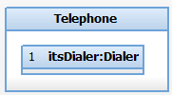
Composite
UML -> Class Diagram ->Relations
Notes:
Good idea to show one of source code examples to show difference between pointer and member variable, lack of setItsDialer, and casting in getItsDialer

Slide 47
Composite with links
UML -> Class Diagram ->Relations

Slide 48
Generalization (Inheritance)
UML -> Class Diagram ->Relations
Model:
Semantics:
B is a subtype of A, B is a A
Examples
A car is a vehicle
A dog is an animal

Slide 49
Example of Generalization (Inheritance)
UML -> Class Diagram ->Relations
Vehicle
Car

Slide 50
Realization
UML -> Class Diagram ->Relations
Model:
Semantics:
B implements interface A
Examples
Triangle implements the Shape interface

Slide 51
Example of Realization
UML -> Class Diagram ->Relations

Slide 52
Usages of UML
The system developer can present the design to stakeholders:
Common language
It is possible that a given UML diagram presents only part of a system. It is possible that a single system will be represented by multiple diagrams, each providing a partial description. The diagram does not necessarily contain all the details
A UML diagram can be used to describe the requirements
The developer will implement the system to realize the described model
Automatic code generation

Slide 53
Executable Modeling
Stages
Code Generation
Build
Model Simulation (Instrumentation)
Notes:
I added this section to help students understand what they are doing in lab when performing “Generate” and “Build”, and to alleviate confusion between component scope and configuration initial instances.

